Slide 1
Value Propositions – global supply chain information hub
Needs: currently most businesses solve supply chain problems (demand planning, manufacturing, sourcing, distribution, logistics, etc.) in isolation with limited or no visibility into global and/or upstream-/down-stream events, while the latter (such as tariffs on demand, port closure on delivery) can have impacts directly or indirectly thru propagation.
Approach
Pub-Sub architecture accommodating complex many-to-many trading relationships.
LLM-powered intelligence extraction from global, local, partner sources.
Cloud-deployed minimizing local footprint accommodating businesses of any sizes.
Open architecture for further extensibility in
On-boarding new trading partners
Plugging-in new data sources
Adding new tools (e.g., LLM-based causality analyzer)
Benefit: horizontal and vertical visibility ensures supply chain resilience.
Competitive analysis: alternative approach suffers in lack of openness due to point-to-point architecture and vendor lock-in.

Slide 2
Global Supply Chain Information Hub
Common Raw Data Ingestion
social media
gov. bulletin
…
weather
LLM Pipeline
NLP
Pattern Recognition
Detection Classification
Parsing
{Source: Tariff, Product: TR-S900, Impact: demand slashed 50%}
Impacting Events
{Source: Typhon, Location: Shanghai, Impact : raw supply delayed 10 days}
{Source: Supplier, Product: UV-K100, Location: TW, Impact : delivery delayed 20 days}
Common inbound
Pub-Sub Channels
Common outbound
Trading Partner X: demand updates
Trading Partner X
Trading Partner Y
Trading Partner Z

Slide 3
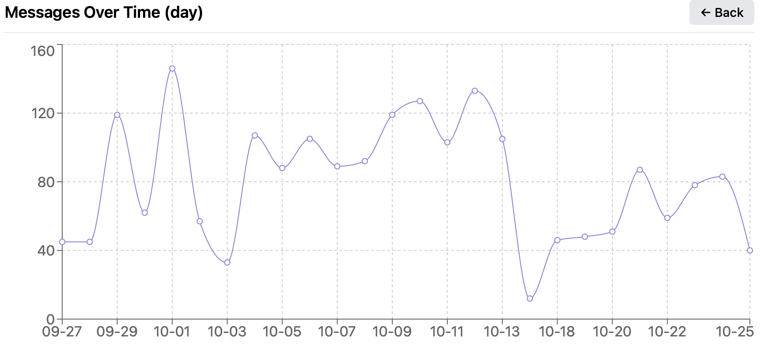
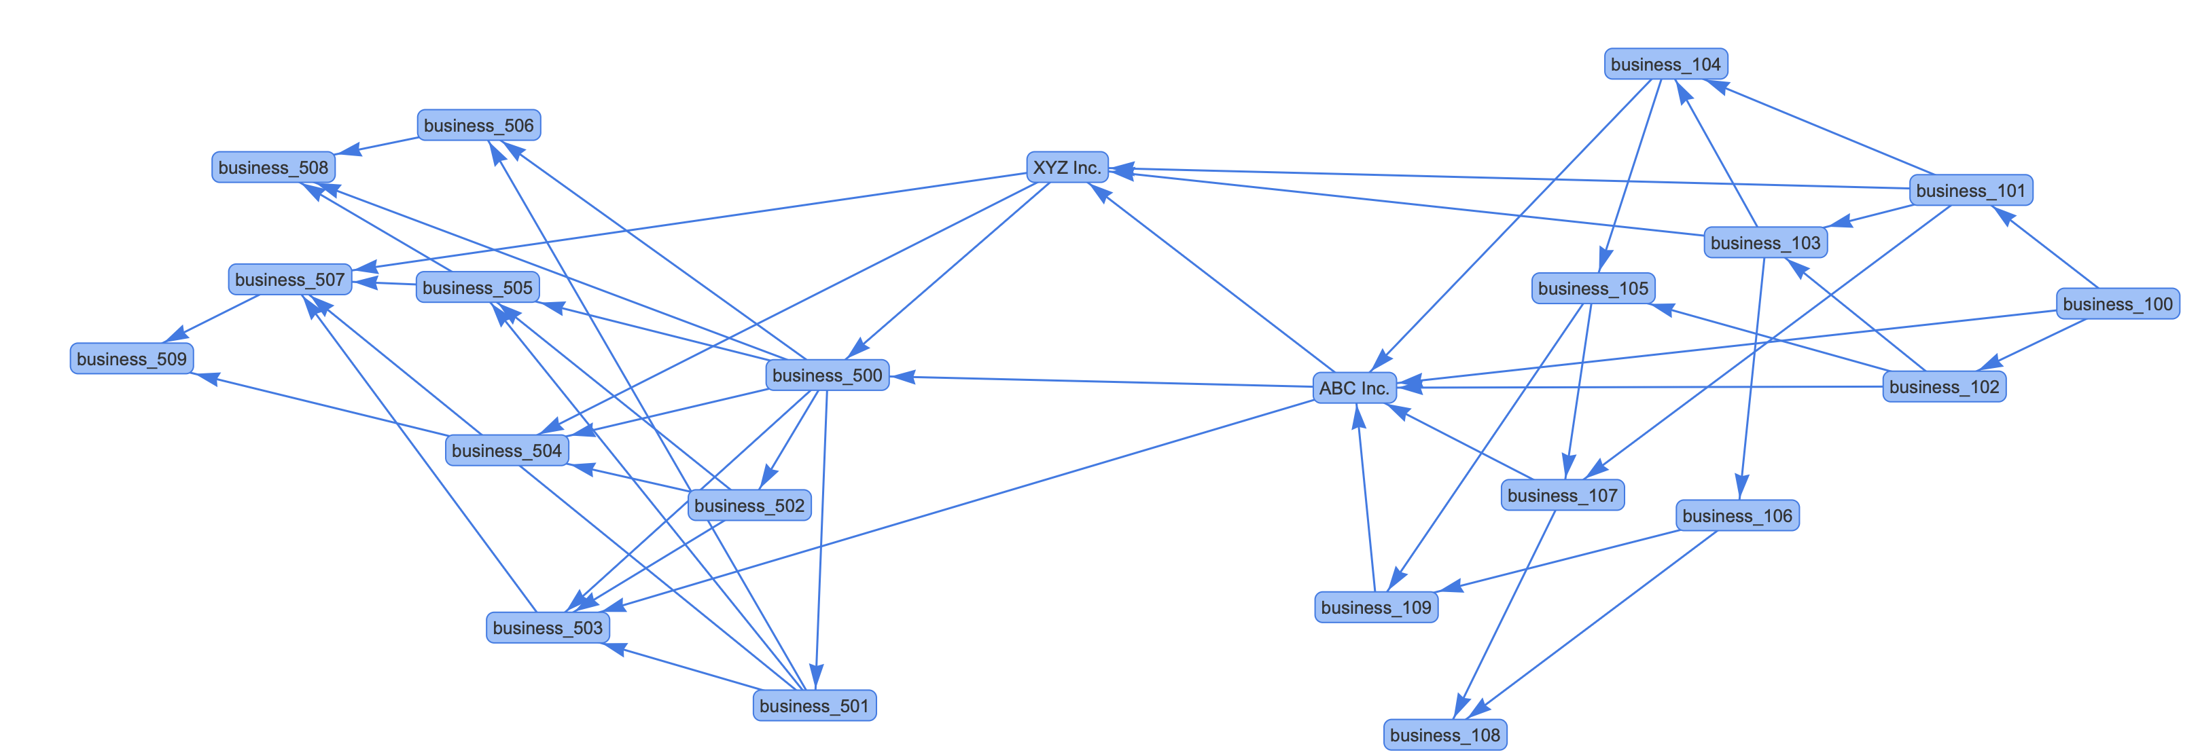
SCIN Architecture
Global Events:
gov. bulletin
weather
social media
Cloud-Deployed SCIN
AI Agent Powered
Workflow
Tooling
Audit
Pattern Recognition
MCP client
Causality LLM (e.g., tariff vs demand, port closed vs delivery delay)
{Source: Tariff, Product: TR-S900, Impact: demand slashed 50%}
{Source: Typhon, Location: Shanghai, Impact : raw supply delayed 10 days}
{Source: Supplier, Product: UV-K100, Location: TW, Impact : delivery delayed 20 days}
Global
Network
Global inbound
Global outbound
Business Inbound
Business Outbound
MCP-Wrapped Supply Chain Engine
MCP-Wrapped Legacy System
Local Events:
shopfloor
support
Business XYZ

Slide 4
Local LLM-Powered Agent
Events
shop floor
support
Global Supply Chain Information Hub
Local Events
Global Events
LLM-based causality analyzer (e.g., tariff vs demand, port closed vs delivery delay)
SCP Solver
Demand
Supply
Capacity
Tools
Workflows
Local events
LLM-Orchestrated Agent
Global events
LLM Reasoning
SCP Solve with adjusted parameters

Slide 5
Global Supply Chain Information Hub
Pub-Sub architecture accommodating complex many-to-many trading relationships (E2open: point-to-point).
Vendor independent (E2open: vendor lock-in).
LLM-powered intelligence extraction from global, local, partner sources.
Cloud-deployed minimizing local footprint accommodating businesses of any sizes.
Open architecture for further extensibility in:
On-boarding new trading partners
Plugging-in new data sources
Adding new tools (e.g., LLM-based causality analyzer)

Slide 6
Service Offerings
Realtime global events curated per material/location.
Realtime upstream/downstream trading partner events pertinent to business operations (e.g., demand/supply updates).
Realtime broadcast/notification of business updates to upstream/downstream trading partners.
Realtime supply chain events (by transitivity) pertinent to business operations (e.g., demand/supply updates).
Integration with in-house supply chain management system.

Slide 7
social media
gov. bulletin
…
weather
Raw Data Ingestion
shop floor
support
Parsing
LLM Pipeline
NLP
Pattern Recognition
Detection/Classification
Impact/Decision
{Source: Tariff, Product: TR-S900, Impact: demand slashed 50%}
{Source: Typhon, Location: Shanghai, Impact : raw supply delayed 10 days}
{Source: Machine Down, Location: TW, Impact : capacity slashed 10%}
Demand
Supply
…
Capacity
Execution
SCP Solver

